Slide 1
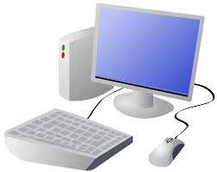
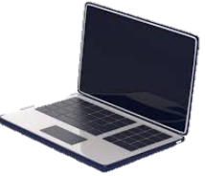
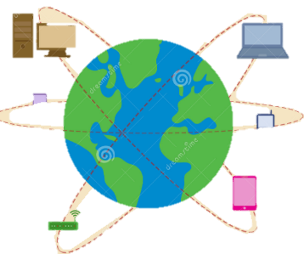
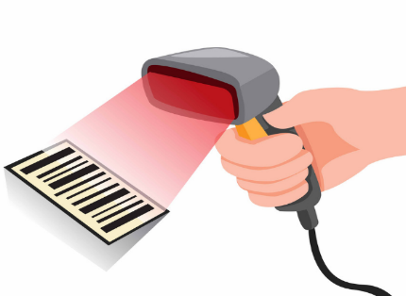
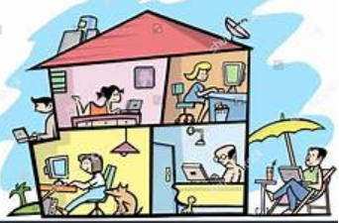
Year 2 Computing & ICT Knowledge Organiser Autumn 1
Computer Systems & Networks – IT Around Us
What is IT?
computers have different parts, which we control to use the computer in different ways. For example, buttons, keys, etc.
Computers also have different ways of letting us know what is happening. For example, screens, lights, and sound.
Key Vocabulary
Computer | A machine used for working with information
Device | A piece of equipment that uses technology
Barcode | An image that uses lines of different thicknesses to represent information
Scanner | A device that changes images or text into electronic form
Communication | The act of giving, receiving, and sharing information
Appliances | A piece of equipment for making a tool or machine suitable for a special purpose
2. IT in schools
Photocopier, digital camera, Ipad, projector are all examples of IT.
3. IT in the world
Barcode scanner, tills, bank card, chip and PIN card reader,
Traffic light, crossing button, crossing signal aare examples of technology in the world
4. The benefits of IT
Computers can read barcodes very quickly
barcodes are scanned at the till, then a beep sounds, and the price appears on a display
5. Using IT safely
We have rules for IT to, Keep us safe, letting us see appropriate content due to watershed or age ratings on games, to stop devices not getting broken
6. Using IT in different ways
We play games, watch or create videos, create pictures using IT
Being mindful using IT is about the amount of time that a learner spends online

