Slide 1
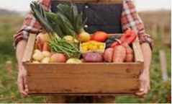
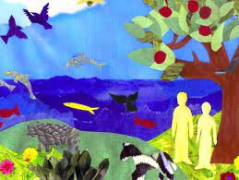
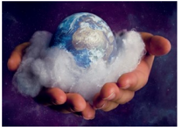
Year 2 RE Knowledge Organiser Autumn 1
Who Created the World?
Who created the world?
God said “Let there be light” and there was light.
God blessed the seventh day and declared it holy for on it he rested from all his work of creation.
Key Vocabulary
Creation | Something that someone has made
Grateful | Being thankful for something good that has been done for you or given to you
Responsibility | To do things you are supposed to do
Prayer | a way to speak to God
Nature | all the animals, plants, and other things in the world that are not made by people
2. Why is Sunday a day of rest?
Sunday is a Holy day in the story of creation.
Sunday is when most people go to church because it was on Sunday that Jesus rose from the dead
3. What is important about harvest?
Harvest festival is about the celebration of all of the things that God gives us.
It is God who makes the crops grow so we need to thank him for providing us with food.
4. Why should we look after our world?
verse from the bible tells us that the earth belongs to God, so we need to look after it.
5. How can we thank God for our world?
Christians say prayers to show that they are thankful.
We often give gifts to say thank you
6. Does everyone believe the world was created in the same way?
Aboriginal people believe in a story of creation ‘Dreamtime’

