Slide 1
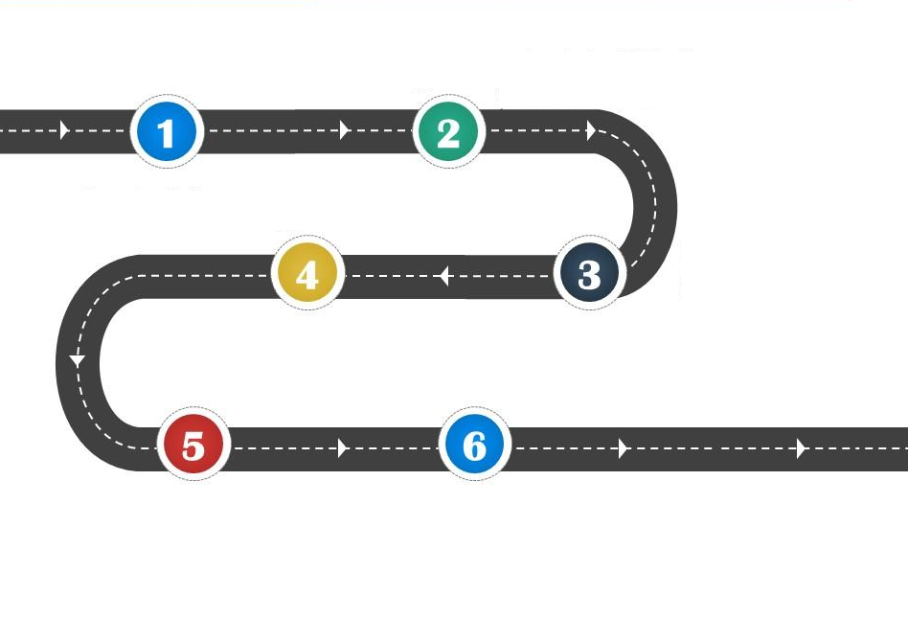
















Year 3
Everyone Welcome
To consider living in Britain today

