Slide 1
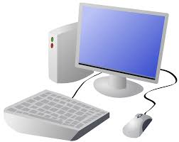


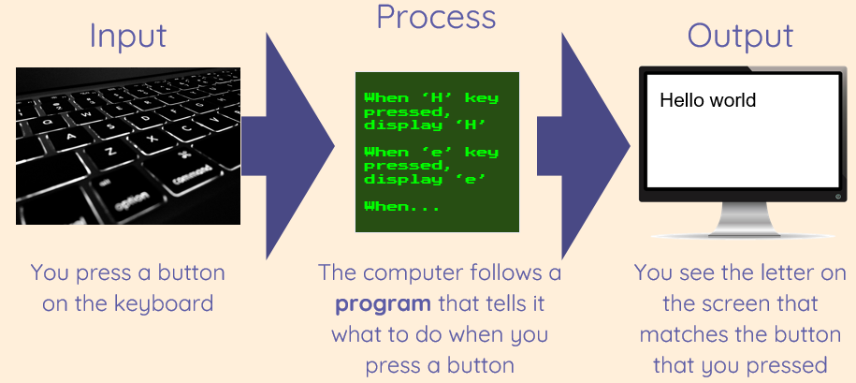
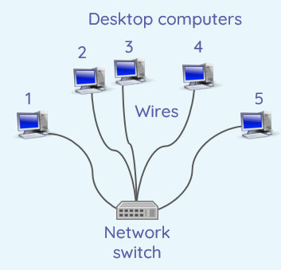
Year 3 Computing Knowledge Organiser Autumn 1
Computing systems and networks – Connecting computers
1. E-safety
We can use text, images, or both text and image to communicate messages.
An image is picture/photograph.
Key Vocabulary
Digital device | A computer or a device with a computer inside that has been programmed for a specific task
Input | Data that is sent to a program to be processed
Output | The result of data processed by a computer
Program | A set of ordered commands that can be run by a computer to complete a task
Computer network | A group of interconnected computing devices
Server | A networked computer that manages, stores, and provides data such as files to other computers
Process | A program, or part of a program, that is running on a computer
2. How does a digital device work?
Digital device must have an input, process and output.
Digital device accepts inputs and they produce outputs.
Camera, computer and IPad are all digital devices.
3. What parts make up a digital device?
Device can have 1 input that leads to several outputs.
Input devices: keyboard, mouse, microphone.
Output devices: speakers, monitor, printer.
4. How do digital devices help us?
Digital devices are all forms of information technology.
Can paint a picture using digital devices.
Using a digital device we can use the undo button.
5. How am I connected?
A computer network collects information (data).
A computer network is simply two more computers joined together to share information.
6. How are computers connected?
A server is a computer that stores files.
A server is connected to a computer network.

