Slide 1


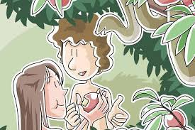
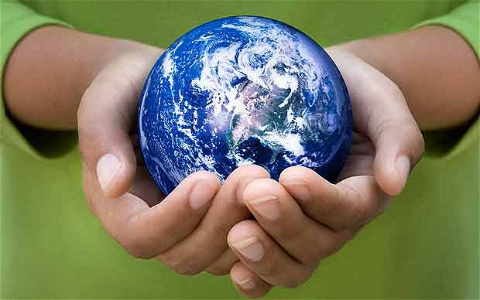
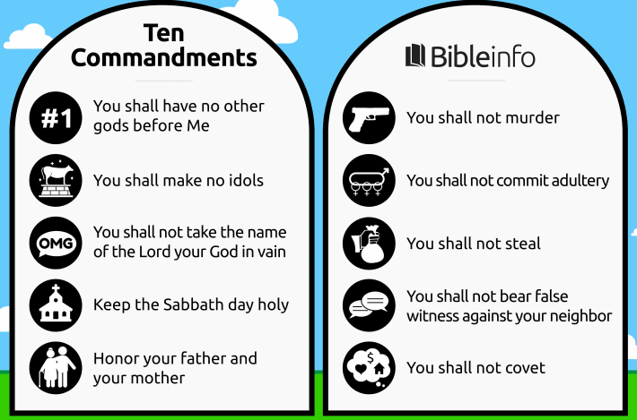
Year 3 RE Knowledge Organiser Autumn 1
What do Christians learn from the Creation Story?
What do Christians believe about the creation story?
Christians believe in the story of The Creation.
Christians believe that God created the universe in 6 days, on the 7th day he rested. It is called a ‘Holy Day’.
The creation story is from Genesis 1:25
Key Vocabulary
Genesis | The first book of the Bible.
‘The Fall’ | Events in the Bible when Adam and Eve are forced to leave the Garden of Eden because they disobeyed God.
Creator | A person or being that creates something.
Forgiveness | Being sorry and having it accepted.
Bible | A group of religious texts. Holy book for Christians.
2. What do Christina believe about God?
God is the creator and humans are responsible for looking after the earth.
Christians believe that human beings are made in God’s image.
Christians believe that God cares for his creation, including humans.
3. What do Christians believe about the Bible?
Christian believe that the Bible guides them in life.
The Bible is a special book for some Christians.
4. Why should we look after the world?
Not everyone is a Christians and not everyone believes that the world was created by God.
Christians believe God made our wonderful world, so we should look after it.
5. What do Christians believe about humans?
The Bible tells a story about how humans spoiled their friendship with God (The Fall).
The Fall means that humans can’t get close to God without God’s help.
Adam and Eve were created by God.
6. What are the ten commandments?
The commandments were given to Moses by God.
Christians believe it is important to say sorry to God for the times we do bad things.

