Slide 1

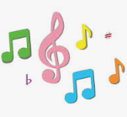
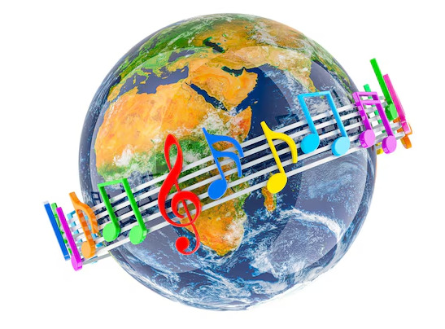
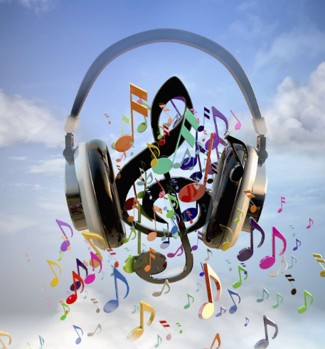
Year 3 Music Knowledge Organiser Autumn 2 - Ballads
What is a ballad?
A ballad is a story written in short phrases which are called stanzas.
A ballad similar to a poem.
A chorus is a repeated sections of music with the same tune and lyrics.
Key Vocabulary
Ballad | A ballad is a poem or song that tells an exciting story. It has a bouncy rhythm and uses short verses that are easy to remember and sing.
Ensemble | A group of people who play musical instruments or sing together, like a band, a choir, or a string quartet.
Compose | Making up a brand-new song, poem, or story. For example, a musician puts musical notes together to compose a tune.
Happy | A happy sound in music is a bright, fast, and bouncy tune that makes people feel joy and want to dance. It usually uses major scales, upbeat rhythms, and lively instruments to create a cheerful and fun mood
2. Performing a Ballad.
The features of a ballad are -telling a story, having chorus, rhyming.
When performing in a group, you need to think about: listening to each other, staying in time, watching the person leading.
3. The Story Behind the Song.
To summarise means to describe something in a few words.
A story mountain is a scheme that helps understand the important points in the story.
Lyrics are the words to a song.
4. Writing Lyrics
Writing lyrics is similar to writing a poem; it will have stanzas (verses)
Rhyming is a repetition of words that sound the same or have a similar ending sound, like 'cat' and 'mat'.
5. Singing My Ballad.
Sing with confidence and up and outwards towards your audience.
Use clear diction so your audience can understand the lyrics.
Nonsense words are words which have no meaning and are often used for filling time in songs - usually pop songs.

