Slide 1


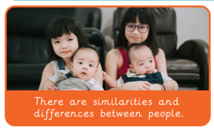
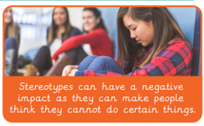
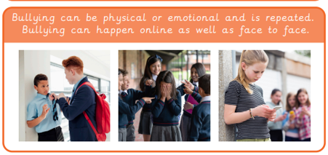
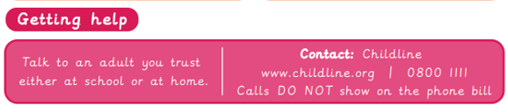
Year 3 PSHE Knowledge Organiser
Autumn 1 – My Healthy Self
Key Vocabulary
Respect | Treating people, places, and things with care and kindness.
Trust | When you believe someone is honest, good, and will keep their promises.
Mental Health | Emotional, psychological, and social well-being. It affects how people think, feel, act, handle stress, and relate to others.
Physical Health | How well and strong a body works. It is about having energy to play, growing properly, eating good food, getting enough sleep, and keeping organs and muscles healthy so you can run, jump, and learn every day.
Support | To hold something up, help a friend, care for a family, or cheer for a sports team
Feelings | Messages from inside your body and brain. They tell you how you react to things around you, like when you smile because you get a toy or cry when you drop your ice cream. Everyone has them, and they change all the time.
Key Knowledge
Rules are things we agree to follow; rules tell us how to behave; rules help us know what is right and wrong; rules help everyone feel safe and treated fairly When lots of people are together; they help stop arguments; they help everyone get a turn; they keep people safe from harm; they help us learn calmly without being distracted.
We all experience the same six emotions, but they do not always feel the same. They can feel comfortable or uncomfortable. They can feel strong or weak and they may feel different each time we experience them. Emotions do not feel exactly the same in everyone's body.
Body clues and face clues are called body language. Noticing clues in our own bodies can help us work out how we might be feeling. Noticing someone’s body language, what they say and what they do can help us work out how they might be feeling
Mood means the way a person feels at a certain time. A person's mood can change throughout the day How we feel can affect our body; this means how our body feels can affect our thoughts and feelings.
Trust is a very important part of relationships and friendships We might trust somebody less is someone is not doing something when they say they will, forgetting something, telling someone else something they shouldn’t have.
If you sleep well, you will find it easier to concentrate, learn and solve problems; the body feels rested and energised; sleep helps the body rest and recover; you are more likely to feel well and happy.

