Slide 1

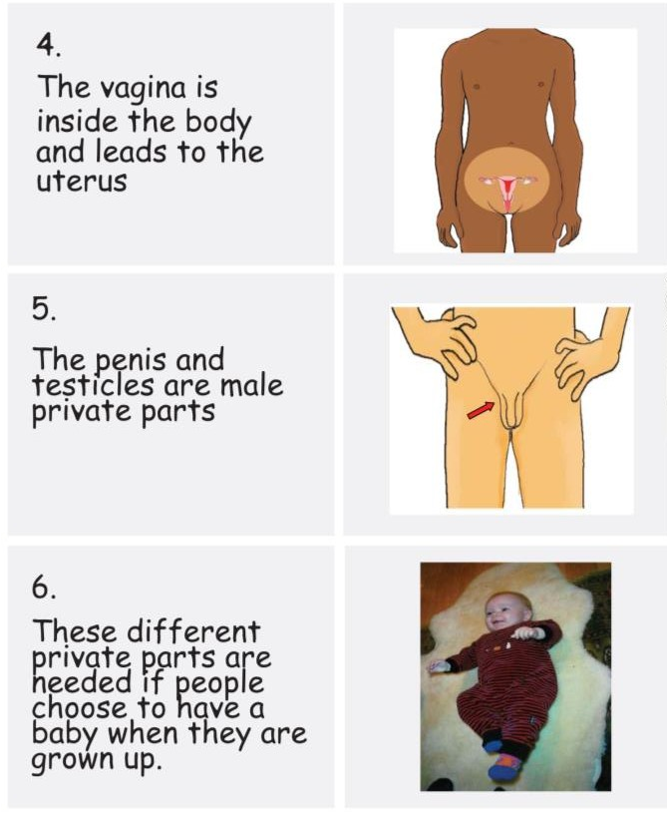
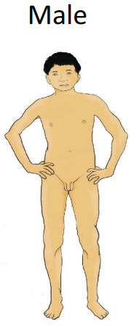
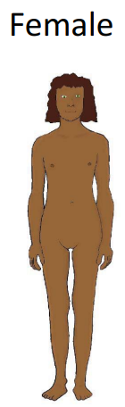
Year 3 RSE Knowledge Organiser Summer Term
Key Vocabulary
fostering | To give care in a family to somebody who is not related by birth or adopted.
adoption | Children that can not be brought up by their birth family, become full permanent and legal member of their new family.
womb | Is an organ in a woman's pelvis where a fetus (unborn baby) grows.
vagina | The female private part
testicles | Two small organs that are found inside the scrotum of a male.
Key Knowledge
It is important to respect someone’s personal space and we can use body language to help us understand when someone feels uncomfortable.
We can identify if a baby is male or female based on their private parts.
Most parts of our bodies are the same. Human bodies are all unique and that not all Female or Male bodies look exactly the same
It is ok to be different. It is never ok to tease or bully someone because their body is different.
The vagina is inside the body and leads up to the uterus, which is the part of the body where a baby can grow. Male and females need different private parts so that when they become adults they will be able to make a baby if they want to.
It is not ok to touch someone else in a way that makes them feel uncomfortable.

