Slide 1



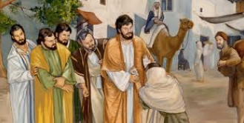
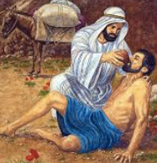
Year 4 RE Knowledge Organiser Autumn 1
What kind of world did Jesus want?
What message did the Gospel Matthew 4:18-19 teach us about Jesus?
Christians believe Jesus challenges everyone about how to live – he sets the example for loving God and your neighbour, putting others first.
Gospel means ‘Good News.’
Key Vocabulary
Gospel | These are four biblical narratives (stories) about the life and death of Jesus. They were written by: St Matthew, St Mark, St Luke and St John.
Disciple | A follower of Jesus during his life.
Christians | A person who believes in Christ and his teachings.
Trinity | The Trinity, or Holy Trinity, is a way of describing God the Father, God the Son and God the Holy Spirit.
Worship | Worship is showing reverence and awe to God, and God alone. In worship, we give thanks, we praise, we sing, we dance, we bring our whole selves (mind, body, and spirit) to spend time with God.
Baptism | Baptism is a Christian religious rite consisting of immersion in or sprinkling with water as a sign that the subject is cleansed from sin and constituted as a member of the Church
Prayer | Prayer is asking God for guidance, being grateful, asking for help and how praying can be like talking to a friend.
2. ‘What did the Gospel Mark 1:40-44 ‘Jesus heals the man with leprosy’ teach us?’
Jesus shows love and forgiveness to unlikely people.
The Gospel is Good News about Jesus – it tells the story of the life and teaching of Jesus. It’s a kind of biography!
Christians try to follow Jesus’ examples of kindness every day.
3. ‘What would a week in the life of a Christian minister look like?’
Christians try to be like Jesus – they want to know him better and better.
Christians try to put his teaching and example into practice in lots of ways, from church worship to social justice.
A church minister leads by example how Jesus would want people to live and helps other to do the same by his teachings.
4. ‘Who is your neighbour?
Your neighbor is everyone and you should treat everyone with respect.
A parable is a simple story which has a special religious or moral meaning at the end. People can learn from parables because stories are easy to remember and they remind us of things we do in our own lives. Jesus told many parables as a way of teaching people important things about God and how we should live.
5. There are a number of Christian Charities that use the word Samaritan in their name – Why??
Jesus showed love in his actions and his stories and its important for Christians to do the same
Christian Aid try to follow Jesus in order to build the kind of world that he wants. Chn work

