Slide 1
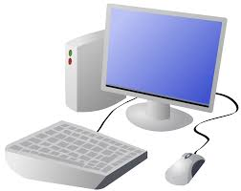

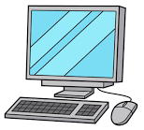
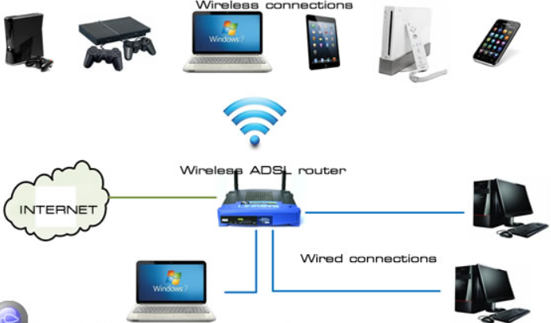
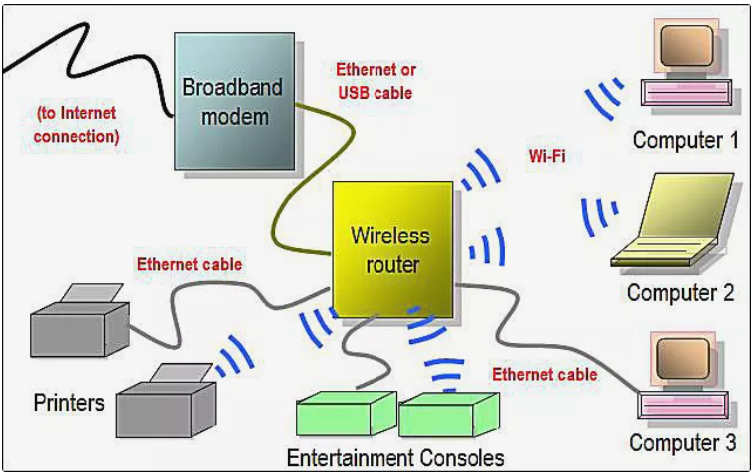
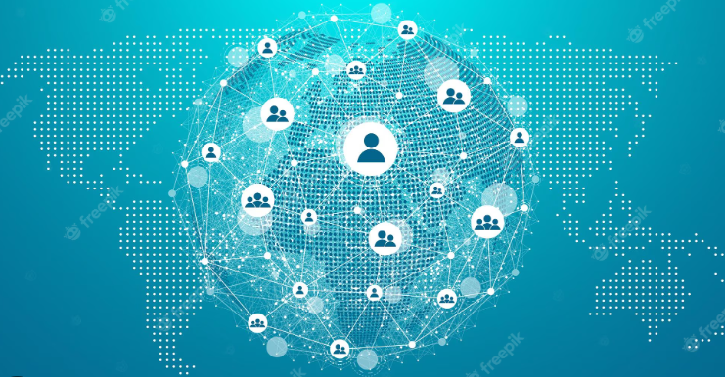
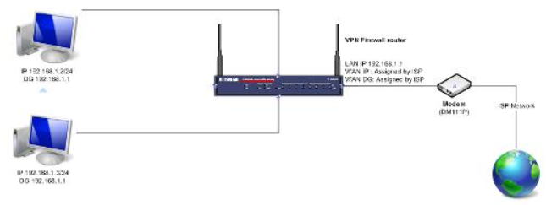
Year 4 Computing & ICT Knowledge Organiser Autumn 1
Connecting Networks
Connecting Networks
The internet is a network of networks.
Information is shared across the internet
A network needs protecting
Key Vocabulary
Internet | The Internet is a network, or system, that connects millions of computers worldwide.
Network | A network is two or more computers (or other electronic devices) that are connected together, usually by cables or Wi-Fi.
WWW | World Wide Web
Router | A router is a box that's looking out for data and when it receives it, it decodes the radio signal back into data and then sends the information to the internet using wires called Ethernet connections.
Download | to transfer (data, files, etc.) from one location (such as a large computer or the cloud) to another (such as a smaller computer, smartphone, or storage device)
Content | Any stored data. On the Internet, content is any information available for retrieval
2. What is the internet made of?
The internet is used to provide many services.
The World Wide Web contains websites and web pages
‘Routing’ A route is a way of getting from one place to another, and that there can be many different routes.
3. Sharing information
The World Wide Web is part of the internet.
A router is a device which directs information around the internet
Chrome is a web browser.
4. What is a website
Websites and their contents are made up of files.
Some common links for a website are; The Logo, links, video clips and text to explain what the website is about.
5. Who owns the web?
Websites and their content are created by people
The Web was invented by Tim Berners-Lee at CERN in 1989 and opened to the public in 1991.
There are rules to protect content
6. Can I believe what I read?
not everything on the World Wide Web is true
some information I find online may not be honest, accurate, or legal
I need to think carefully before I share or reshare content

