Slide 1
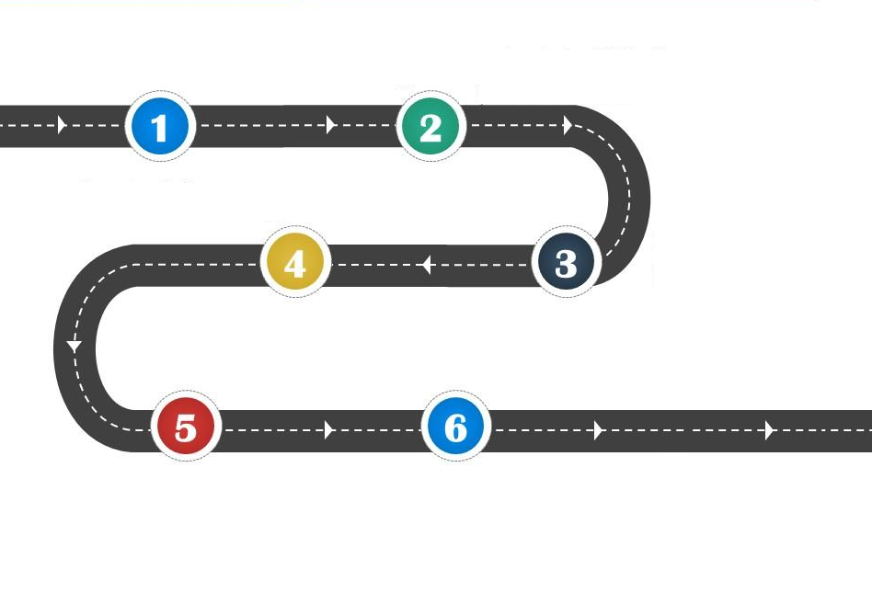
















To be proud of who I am
To understand people can make their own choices
To look after our mental health
To find common good
Year 4
Everyone Welcome
To choose when to be assertive
To help someone accept difference

