Slide 1



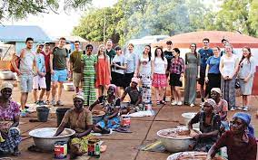
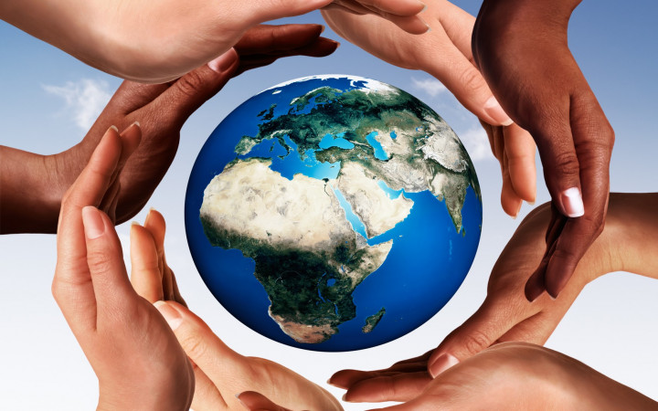
Year 3 RE Knowledge Organiser Summer 2
How and why do people try to make the world a better place?
What’s wrong with the world?
Selfishness/lack of love/humans are all examples of what could be wrong with the world today.
Religion helps people understand what is wrong with the world.
Humanists believe that humans are responsible for making the world a better place.
Key Vocabulary
Humanist | Humanists do not believe in a God.
Charity | Charity is an act of giving help to those in need of it.
Sacrifice | A sacrifice is giving something up.
Golden Rules | Rules which tells us how to treat others.
Tzedek | It means ‘justice’ in Hebrew. It is also the name of a UK-based charity.
Selfishness | Being selfish is when you are only thinking about yourself and not about others.
Generosity | It is the act of giving what you have to others.
2. How can the ‘Golden Rules’ help people to work out how to make the world a better place?
Religion gives people help and guidelines to live in the right way.
Golden Rule : Treat others how you would like to be treated.
Different religions have their own set of ‘Golden Rules’.
3. How do Jewish people try to make the world a better place?
The Jewish teaching ‘tikkun olam’ is about repairing the world.
Tzedek is a Jewish charity that try to help the world.
Anyone is able to ‘repair the world’.
4. Who is inspired by Jesus’ example of sacrifice?
Christians believe that God made a perfect world, but that sin spoilt it and terrible things happened.
Christians believe that Jesus was sent to save the people and bring them back to God.
Christians believe Jesus died so that people can be forgiven.
5. How do Muslims try to make the world a better place?
Zakat is one of the five pillars of Islam.
Each year Muslims try to give 2.5% (if they can afford it) of what they earn to charity or the needy.
Muslims believe they are caring for the worldwide Muslim family, the Ummah.

