Slide 1
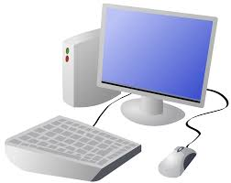


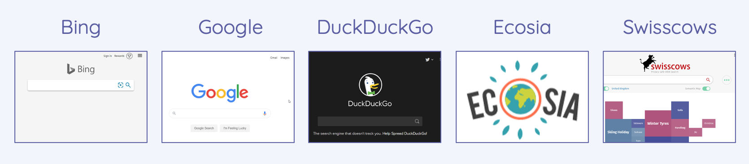
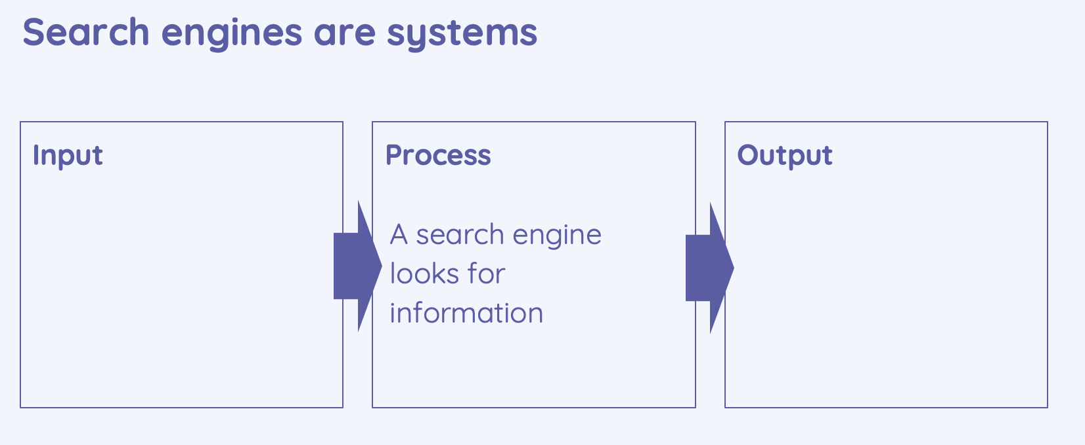
Year 5 Computing & ICT Knowledge Organiser Autumn 1
Computing Systems and networks- Systems and searching.
Key Vocabulary
System | Set of things working together as parts of a whole. E.g. the brake system in your bike.
Connection | When various parts of a network link together.
Digital input | Any information or data that is sent to a computer for processing.
Process | The programme running in a computer
Output | The result of what comes out the computer when it has processed the information and carried out the task.
Address | A way to identify something.
Systems
Systems are an interconnecting network working together.
Systems must have inputs (something going ’in’) and outputs (the result coming ‘out’).
2. Computing systems and us
Systems are all around us in every day life. They are there to HELP us.
Puffins are an example of an everyday systems. It includes sensors, which help keep pedestrians safe. It can cope with people walking at different speeds and keeps the traffic stationary for only as long as is necessary.
3. Searching the Web
Search engines (such as Google and Bing) can be used to find information.
Address boxes can also be used to search for websites.
When search, the input must be specific.
4. Selecting search results
Search engines use indexes to find what we need.
Search engines use programs called web crawlers to create an index of the web
When you enter a search term, the search engine selects results from its index. It does not need to search every web page on the internet.
5. How search results are ranked and influenced
Website creators design sites so they will rank highly in searches. This is known as search engine optimisation (SEO).
Search engines can tell when a search term has been repeated in an unnatural way.
The rules (algorithms) are different for each search engine.

