Slide 1
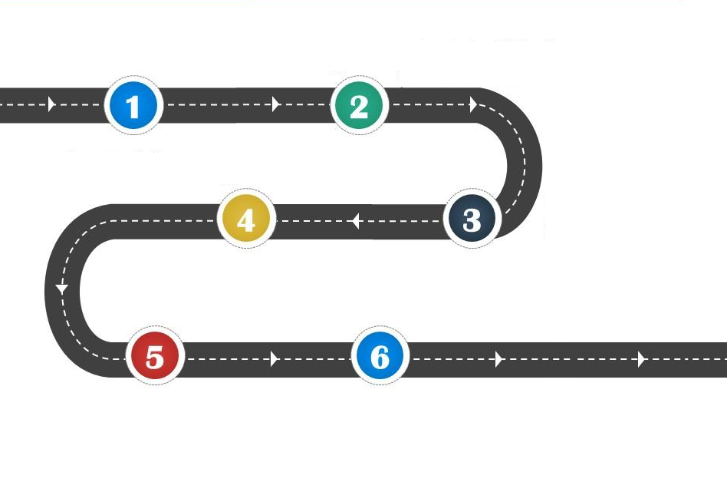


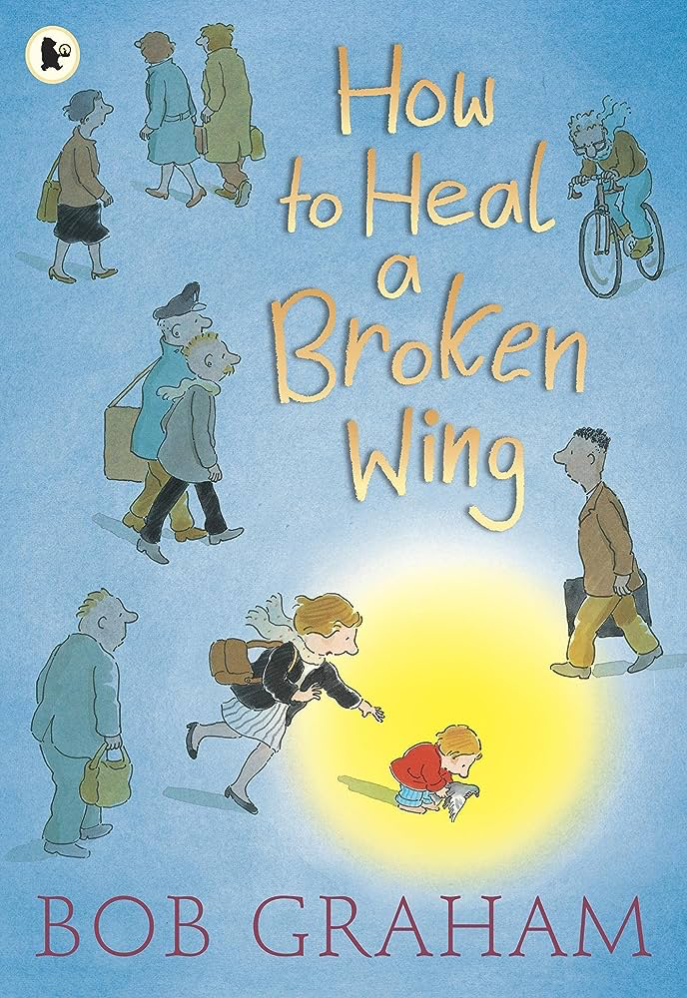













To consider consequences
To justify my actions
To recognise when someone needs help
To consider responses to racist behaviour
Year 5
Everyone Welcome
To explore friendship
To exchange dialogue and express opinion.

