Slide 1
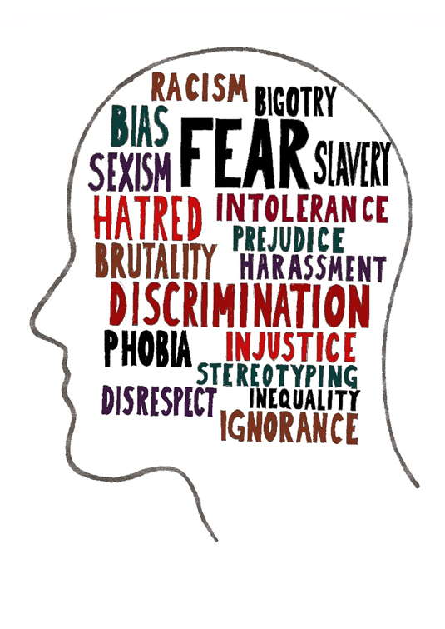
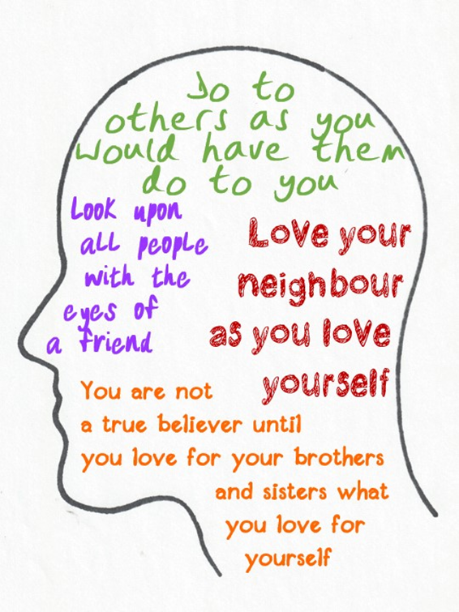
Year 6 RE Knowledge Organiser Autumn term 1
Anti-Racist RE: What can be done to reduce racism? Can religion help?
1. Racism: What is it, and why is it unfair?
Racism is a kind of unfairness. It is about people’s lives being made worse just because of their race, the colour of their skin or their ethnic group.
Religious holy books speak about treating others with goodness and fairness.
Key Vocabulary
Tolerance | The ability or willingness to tolerate the existence of opinions or behaviour that one dislikes or disagrees with.
White privilege | Inherent advantages possessed by a white person on the basis of their race.
Hate speech | Abusive or threatening speech or writing that expresses prejudice against a particular group.
Justice | Just behaviour or treatment.
Ethnicity | The fact or state of belonging to a social group that has a common national or cultural tradition.
Racism | The belief that different races possess distinct characteristics, abilities, or qualities, especially so as to distinguish them as inferior or superior to one another.ng to science
Prejudice | Preconceived opinion that is not based on reason or actual experience.
Fairness | Impartial and just treatment or behaviour without favouritism or discrimination.
2. What can we learn from the stories of two statues in Bristol?
Bristol’s statue of Edward Colston was racially offensive, but the statue of John Wesley celebrates anti-slavery.
Edward Colston’s statue was dumped in Bristol docks by ‘Black Lives Matter’ protestors in spring 2020.
3. How did Saint Peter learn that ‘God has no favourites’?
This story matters to Christians very much because it is the moment when the new religion of Jesus stopped being ‘just for Jewish people’ and became something for everyone.
4. How do Christians view science and religion?
“Treating others as you want them to treat you is a democratic thing to do because it means each person counts for one in the community, whatever their race or religion.”
5. How do Christians worship God as the creator?
Rosa Parks: She started the ‘bus boycott’ by refusing to give her seat to a white person. Thousands of black people boycotted the busses after this, and they won the right to sit wherever they wished on busses after that.
6. How can I express my own vision for justice and quality?
Jo Cox: was a Humanist, but she worked with and for people from different religions as well.
Jo Cox stood against racism, and was murdered by a person who hated her for that.

