Slide 1
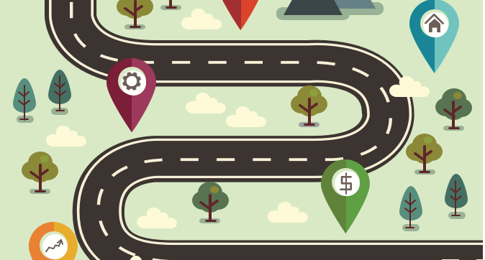
6. This time we will work in 4s to perform a range of symmetrical and asymmetrical counter balances at different levels
5. We will then perform some of our earlier work for others to evaluate against before adding in a move in canon. We will then perform and evaluate again
4. Following this, we will begin looking at a range of symmetrical counter tension balances at different levels, building on earlier work to generate a routine
Gymnastics: PE: Year 6
3. We will consider effective transitional moves and explore different pathways to combine balancing moves. We will be practise holding balances at different heights before travelling to a different counter balance.
2. Next we will focus on counter balancing – including push and pull forces. We will be working with a partner and communicating. We will consider the importance of a stable base, body tension, eye contact, extension and control.
1. In today’s lesson we will be developing a range of balances on different body parts, keeping clear shapes and lines, holding balances comfortably and moving elegantly from one balance to another

