Slide 1
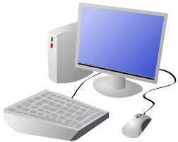


Year 6 Computing & ICT Knowledge Organiser Autumn 2
Creating Media: Web Page Creation
1.What makes a good website
A website is a collection of information relating to a particular topic. Websites can be accessed on a range of devices
Websites can be made up of lots of different web pages
Key Vocabulary
Website | A set of related web pages located under a single domain name
Webpage | Web pages make up different websites
Copyright | A law that gives the owner of a piece of work the right to decide what other people can do with it
Browser | Allows people to navigate or find their way around the World Wide Web
Hyperlink | A way to connect one thing on the internet to another thing
Media | Media includes images, sounds, video or animations that complement the text on the website
2. How would you lay out your webpage?
Web pages include the website name, a logo, headers (banners), information and different media
Websites are created for a purpose
3. Copyright or copyWRONG?
If you want access to someone else’s work you should ask permission, give credit to the person who made it or buy it (if it has a cost attached)
4. How does it look?
When creating web pages on Google Sites, it is important to view how the web page looks on different devices
5. Follow the breadcrumbs
Breadcrumb trails (or navigation paths help you when navigating a website. They allow users to keep track of where they have been on the website
6. Think before you link
When adding links to external websites it is important to consider factors: the link might change, content might change. The site might not be secure or might not be trustworthy.
Remember to also give creadit to the site

