Slide 1
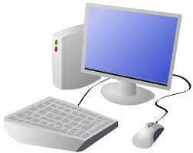


Year 6 Computing & ICT Knowledge Organiser Autumn 1
Computing systems and networks – communication and collaboration
1.Internet addresses
Networked computers use special addresses called IP addresses and they use numbers. IP stands for Internet Protocol
The Domain Name Server matches IP to the domains (which is a website address
Key Vocabulary
Communication | Where information is exchanged between individuals online
Public | Information which is open view for everyone to see
Private | Information shared with a particular person or group only
Internet | This is a global computer network providing information and communication facilities
Search engine | A program, like Google, that searches for items in a database
Collaboration | Working with someone to produce something
2. Data packets
Computers send data across the internet in packets
Packers have two main parts: the header (this contains the address and other key information in, including sender’s address) and the data payload (the message)
3. Working together
Sharing information online can help people work together
Working collaboratively can include creating a shared bank of information
4. Shared working
There are different ways of working together online
Shared work can also involve taking someone else’s work and making it their own version – but watch out for copyright – you need to get permission first!
5. How we communicate
There are many different ways on which we can communicate using the internet: websites, online messaging (including WhatsApp and email), social media platforms
6. Communicating responsibly
We need to be mindful when sharing on line as to whether the information is public or private.
We need to be respectful of others when communicating online

